Slide 1
2026 Maternity Survey Trust Webinar 2
16th February 2026

Slide 2
Contents
Overview of 2026 survey [5 mins]
Sampling and contact approach [10 mins]
Instruction manuals [10 mins]
Discussion of common queries and potential sampling errors [15 mins]
Questionnaire development: survey questions [10 mins]
Service user-facing materials [10 mins]
Data Protection and Section 251 Requirements [5 mins]
Demographic Batch Service (DBS) checks [5 mins]
Entering fieldwork [5 mins]
Key dates [5 mins]
Questions [10 mins]

Slide 3
Overview of 2026 Maternity Survey (MAT26)

Slide 4
Overview of 2026 Maternity Survey (MAT26)
Mixed mode approach
First adopted in 2021 (push to web approach) and been used since.
Online survey options:
For in-house trusts: centralised online survey tool provided by the Survey Coordination Centre (SCC).
Approved contractors may provide their own online survey tool, if preferred, which should meet the NPSP wide specifications.
Contact approach remains the same as in 2025.
Sampling
Eligibility criteria and core sampling approach remain same as in 2025 (February births, census of all live births, sample of at least 300).
No changes to sampling variables.
Questionnaire
2026 survey aims to keep trend data where possible.
Updates were made following stakeholder, front line staff and service user consultations.

Slide 5
Sampling and contact approach

Slide 6

Sampling: Instructions
The sample for the Maternity Survey is selected from adult service users aged 16 years or older at the time of delivery.
You must select service users who consecutively gave birth at your trust, working back from the last day of February 2026, until your initial sample consists of 350 service users.
This will allow for the removal of some service users following checks (e.g., deceased service users removed after DBS and local checks conducted) to provide a final sample size of at least 300 service users.
Records are removed following DBS checks if the mother and/or their baby is deceased. The maternity survey considers outcomes for both the mother and the baby.
Feb
2026

Slide 7
Sampling: Instructions
For certain trusts sampling back into January 2026 may be necessary to meet the final minimum sample size of 300 service users. If you need to sample back:
You must sample back into January consecutively, working back from the last day of January 2026, until your initial sample consists of 300.
If you need to sample back into January, your final sample size must not exceed 300.
You must not sample back further than 1 January 2026. If you reach 1 January 2026 and still have not achieved the sample size of 300, please submit the sample with the number of eligible service users that you have. Please confirm your final sample size with your approved contractor and the SCC team.
You must detail the reason for not meeting the sample size of 300 in the sample declaration form.
Specialist trusts who cannot meet this sample size must ensure their sample size is consistent with prior years. You must inform your approved contractor and the SCC team as detailed above.
Jan - Feb
2026

Slide 8


Sample criteria: Eligibility criteria
All maternity service users (aged 16 and above at the time of delivery) who gave birth during February 2026 (unless you are sampling further back to January to achieve the minimum final sample size of 300 live births):
Deliveries at any NHS unit managed by the trust.
Deliveries that took place at home.
All types of deliveries.
Multiparous and primiparous persons.
Incomplete addresses.
Service users remain eligible even if they do not have an NHS number. However, NHS numbers are important for DBS checks to ensure survey letters are not sent to bereaved families.

Slide 9

Sample criteria: Eligibility criteria
Please do not include persons who:
Were under 16 years of age at the time of delivery.
Had a stillbirth / baby or mother have died during or since delivery.
Baby or mother are in hospital at the time of drawing the sample.
Had a concealed pregnancy or had their baby taken into care.
Were non-NHS service users and gave birth at a private maternity unit, wing or hospital.
Don’t have a useable postal address.
Address is outside of the UK.
Have requested that their details should only be used for clinical purposes and nothing else.

Slide 10

Sampling variables: changes since 2025
Patient Record Number (PRN)
New format for MAT26: MAT26XXXNNNN
‘MAT26’ = survey code
‘XXX’ = trust code (e.g., R1H)
‘NNNN’ = assigned record number (e.g., 0001)
For example: MAT26R1H0001
For 2026, the sample variables remain the same, the only change is the format of the PRN.

Slide 11


Neonatal care variable: discussion
Coding in the sample construction spreadsheet:
1 = NICU 2 = SCBU 3 = LNU
4 = Transitional care (babies are admitted to transitional care for treatments such as mild jaundice, feeding problems, being kept warm)
5 = Outreach (babies who receive additional specialist care at home e.g., home oxygen, feeding problems/poor weight gain, complex medication regimes)
6 = Baby received neonatal care in multiple units (babies who received neonatal care in more than one unit, e.g. NICU, SCBU, LNU, transitional, and outreach care)
7 = Baby did not receive neonatal care
8 = Not known
In 2024, the Neonatal care variable was added:
Neonatal care
Record if a service user’s baby received neonatal care and if so, in which unit.
Is the coding easy to understand?
Is the coding feasible / achievable?
Do we need all the codes, or could they be simplified?

Slide 12
Contact approach
Contact | Type | Content of contact | Example of mailing day
Day 0 | Postal | Invitation letter with URL and QR code for online survey Multi-language sheet with QR codes | Tuesday
Day 3 | SMS | SMS reminder (if phone number available) | Friday
Day 14 | Postal | Reminder letter with URL and QR code for online survey Multilanguage sheet with QR codes | Tuesday
Day 17 | SMS | SMS reminder (if phone number available) | Friday
Day 28 | Postal | Reminder letter with URL and QR code for online survey Paper Questionnaire Freepost return envelope Multilanguage sheet with QR codes | Tuesday
Day 42 | Postal | Reminder letter with URL and QR code for online survey Multilanguage sheet with QR codes | Tuesday
Day 45 | SMS | SMS reminder (if phone number available) | Friday
Please ensure that DBS and local checks are provided in plenty of time to allow mailings to be sent on time.
Trusts will need to work alongside their approved contractors to agree on dates to complete these checks before the start of fieldwork.
DBS and local checks will be covered in additional detail later in the presentation.

Slide 13
Instruction manuals

Slide 14


Survey Handbook
For survey leads:
Document outlining step-by-step process for preparing and running the survey.
It is a key summary document that links to all other relevant information regarding the survey handbook.
Includes:
What’s new for the 2026 Maternity Survey (including updated specifications for the online survey tool).
Tips on managing and implementing the survey.
Key dates: top level.
Highlights on key information e.g. S251.
This will be available on the NHS Maternity Survey website on 24th February

Slide 15
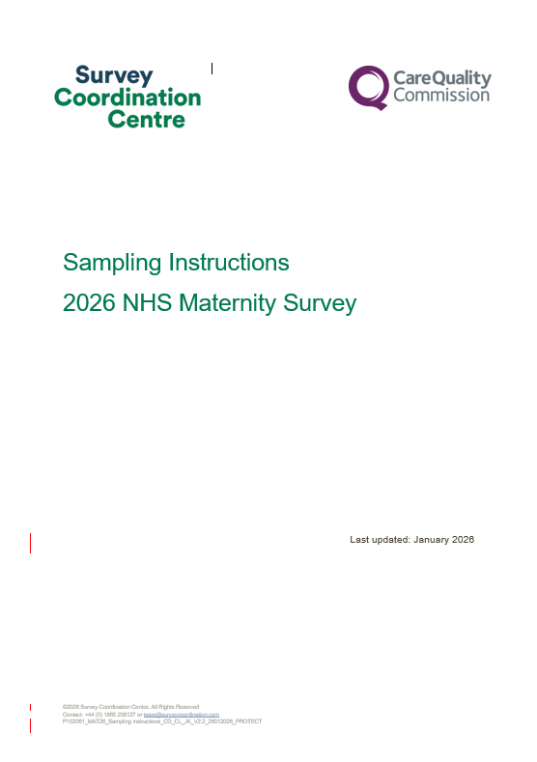
Sampling Instructions
For sample drawers (data team):
Document outlining step-by-step process of how to draw your sample.
Key summary document that links to all other relevant information regarding survey sampling.
Includes:
Overview of the sample drawing process.
Details on eligible and ineligible patients.
Information on DBS checks for deceased patients.
Checking and submitting your sample.
This will be available on the NHS Maternity Survey website on 24th February

Slide 16
Other Documents
Sample Declaration Forms
Sample Construction Spreadsheets
To be used to construct the sample of eligible patients for the survey
Two versions are available depending on whether you will be using a contractor to conduct fieldwork on your behalf or conducing the survey in-house.
Each version will contain all relevant fields for the sample details, mailing details and fieldwork variables.
To be used to check your sample has been correctly drawn before submission to your contractor or the SCC
Two versions are available depending on whether you will be using a contractor to conduct fieldwork on your behalf or conducing the survey inhouse.
Includes – instructions, checklist, declaration agreement.
Must be signed by the sample drawer AND your Caldicott Guardian prior to submission.
This will be available on the NHS Maternity Survey website on 24th February

Slide 17
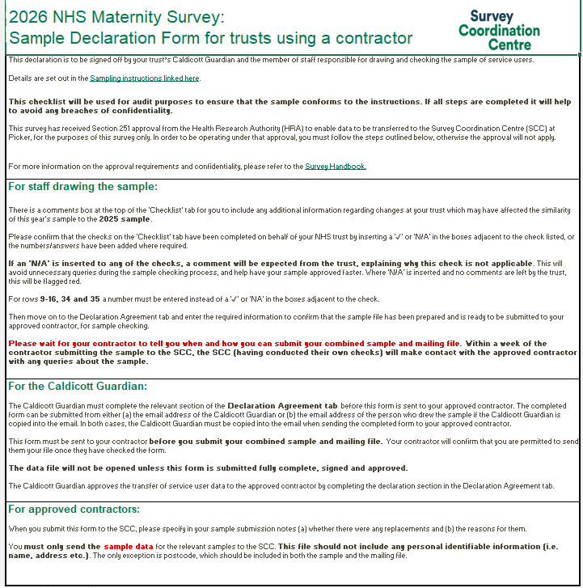
Sample Declaration Form: ‘Instructions’ tab
Completing the Sample Declaration Form can help avoid errors. Avoiding errors will ensure the fieldwork launch can happen earlier. Starting on time allows the full use of fieldwork period, which may improve response rates. The Sample Declaration form includes:
‘Instructions’ tab
This includes information on how to complete the declaration form correctly. It’s recommended that this is reviewed ahead of completing the form.

Slide 18
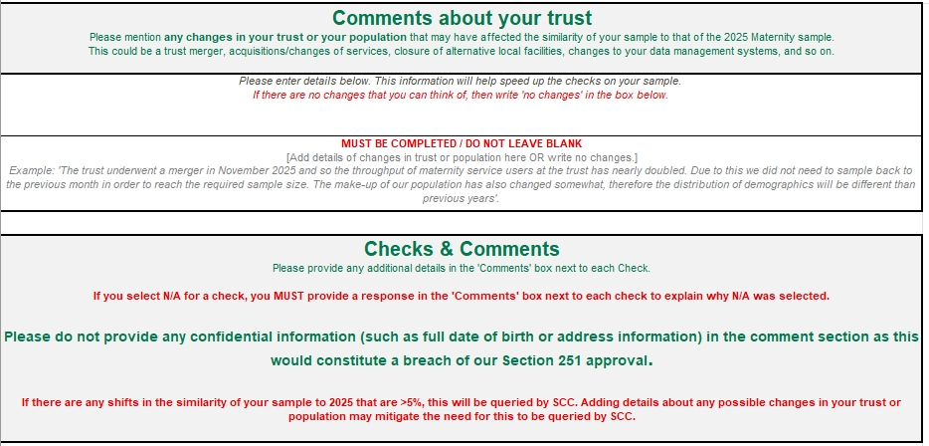

Sample Declaration Form: ‘Checklist’ tab (1)
‘Checklist’ tab
The “Comments about your trust” section MUST be completed – if there are no changes in your trust this year that could affect the comparability of your sample to last year e.g. trust merger, acquisitions / changes of services etc, then you can write “No changes” in this section. Do not leave this section blank.
All checks must be completed – if you have added “N/A” for a check, the “Comments” column MUST be completed. Missing information can cause delays to the approval of your sample.
If there are checks where you are unsure what information is required, please consult your approved contractor or the SCC team.

Slide 19
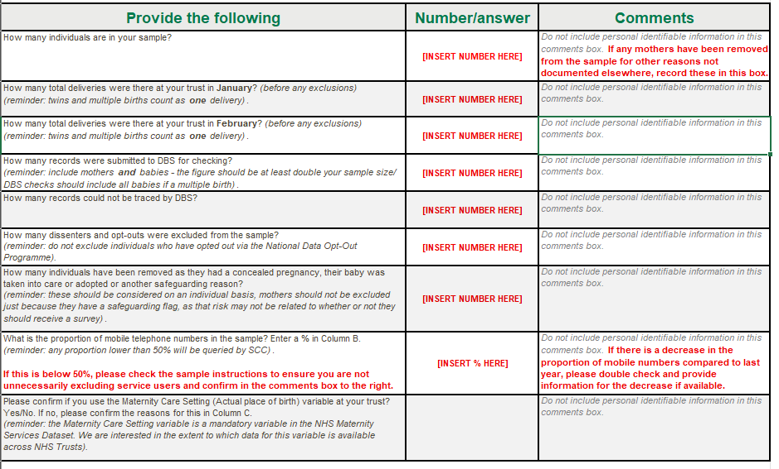
Sample Declaration Form: ‘Checklist’ tab (2)
‘Checklist’ tab
Make sure to add a number or percentage where indicated in the middle column by [INSERT NUMBER HERE] or [INSERT % HERE].
Any additional instructions are highlighted by red bold text.
We will query any shifts of >5% since 2025. This is to ensure that the sample characteristics haven’t changed significantly from the previous year - significant changes in sample characteristics may affect benchmarking.

Slide 20
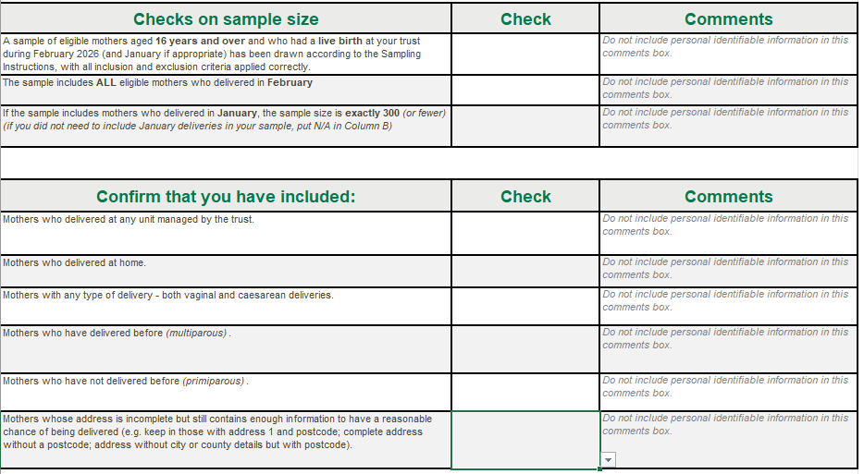
Sample Declaration Form: ‘Checklist’ tab (3)
‘Checklist’ tab
You should complete the dropdown ‘Check’ for each row.

Slide 21
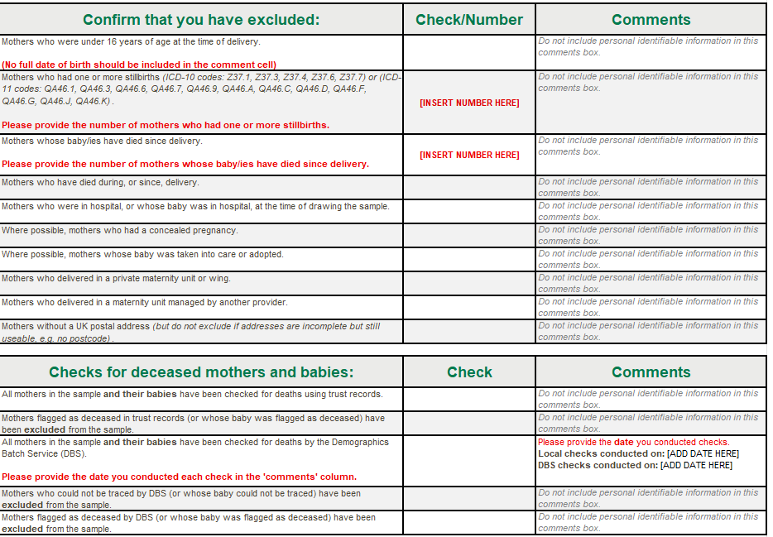
Sample Declaration Form: ‘Checklist’ tab (4)
‘Checklist’ tab
Please provide dates when the local checks and DBS checks were conducted.

Slide 22
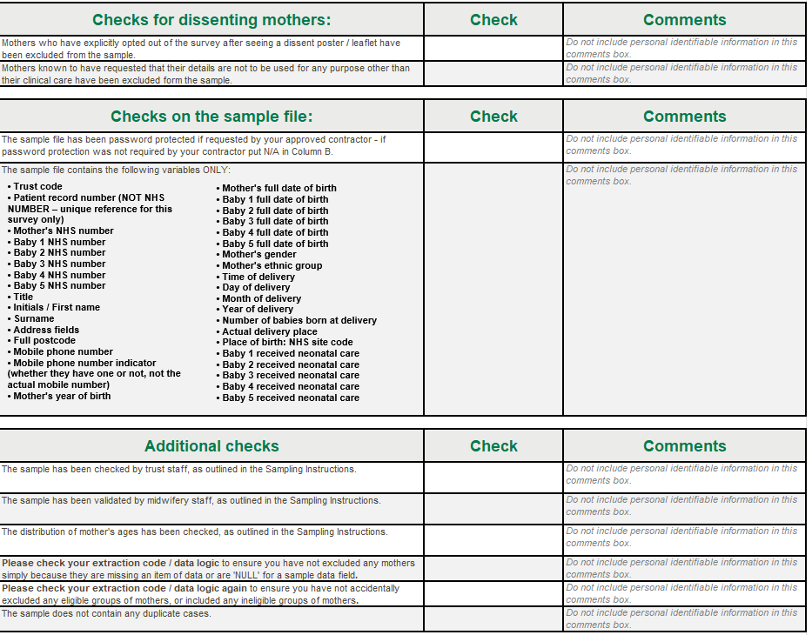
Sample Declaration Form: ‘Checklist’ tab (5)
‘Checklist’ tab
Please make sure that the ‘Check’ column is complete for every row.

Slide 23
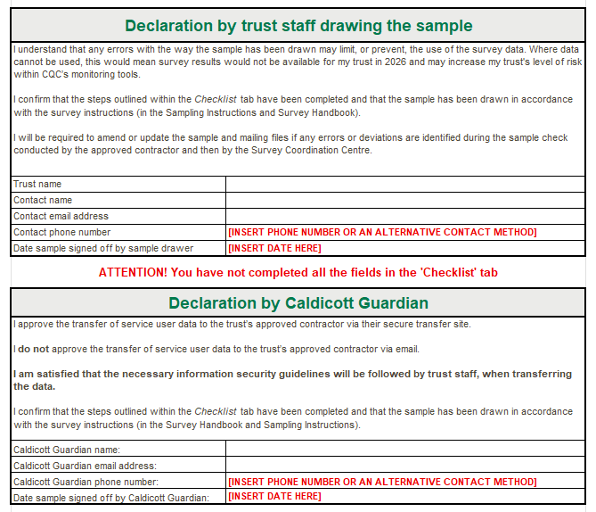
Sample Declaration Form: ‘Declaration agreement’ tab
‘Declaration Agreement’ tab
This must be completed and signed by BOTH the individual who has drawn the sample for your trust AND your Caldicott Guardian.
The date the sample has been signed off by both individuals, along with email addresses and contact numbers must also be added.
Missing information can delay the approval of your sample.
Make sure to enter a contact number or explain an alternative contact method e.g. “I don’t have a phone number, please use email”.

Slide 24

Sample Declaration Form
Submitting your Sample Declaration Form:
Sample declaration forms are to be submitted to your approved contractor (or the SCC team if you are an in-house trust).
Once the form has been approved, please submit your sample safely via the secure file transfer site.
Tips
Take care to fill in dates.
Schedule time for sign-off in advance with Caldicott Guardian.
We will query any unexplained shifts of >5% in your sample, so it’s best to provide as much detail about any changes since 2025 as you can.

Slide 25
Discussion of common queries and potential sampling errors

Slide 26
Discussion of common trust queries
Can my trust still participate even though we can’t reach the minimum sample size? Yes, although you may not receive full results, we would still encourage you to take part. Please let SCC and your contractor know if your sample will be less than 300.
There is a service user whose baby received some additional care on the Postnatal Ward. How should this be coded under the neonatal care variable? This should be 4: ‘Transitional care (babies are admitted to transitional care for treatments such as mild jaundice, feeding problems, being kept warm)’.
There is a service user who comes out in our data extract as being anonymised due to having a sensitive condition (e.g. HIV). We therefore have no patient level details for them. Can they still be included? Sensitive conditions/procedures aren’t explicitly specified, however, the patient details have been kept confidential. So, they should not be included in the sample.

Slide 27
Check sample prior to submission
Your sample size must be at least 300 – there is no maximum sample size for February births
Examples of checks you should do before submitting your sample:
Check distribution of service user ages in your sample (especially those aged 16, 17 and 18 years).
Check that mobile numbers are included and correct. There should be no landline numbers and there should be 11 digits in each number.
Check coding of Actual Delivery Place (ADP).
Check that site codes are not present for individuals with ADP 1 (home births), 5 (private hospital) or 8 (deliveries that took place outside the trust). Also leave the site code blank if the ADP is 9 (Not known), unless you know that the delivery took place in hospital.
Check that individuals with missing information are NOT excluded.
Check that you have not excluded individuals with safeguarding flags without consulting the safeguarding team.
Check that you have included home births.
Check that you have sampled the correct period.
Check that your sample includes ALL eligible maternity service users who gave birth in February, regardless of whether you had to sample back into January or not.
If the submission of boosted samples have been agreed with your contractor, these should not be shared with the SCC.
For further information, please refer to the Sampling Instructions document on the NHS patient surveys website, which will be available at the end of February.
Notes:
Discuss examples of common sampling errors from previous experiences:
Individuals with an Actual Delivery Place (ADP) of 1, 5, 8 or 9 should not have a site code. This is because. the service user has not given birth at a hospital site.
If there are any dates missing when you have sampled back consecutively e.g. if you have sampled back to the 1st Feb, but 7th Feb is missing, we would query this to make sure no births have been incorrectly missed. If you can see a missing date, please add a note to confirm whether this is correct.
Correct and consistent formatting e.g. time of birth should be NN:NN e.g. 08:37 and not 8:37, and no double spacings between postcodes.
Across all information provided, we will query any shift of more than 5% since last year, so please provide as much detail as possible which may help to explain shifts e.g. changes to systems, changes within the trust.
In your final sample, all respondents and their babies should have undergone a DBS check.
Any changes in you sample size since you submitted your SDF must be reported with a reason.
Be aware of system migrations, as they can lead to downtime which can delay drawing your sample or introduce significant shifts in the demographic proportions compared to the previous survey year.

Slide 28
Questionnaire development: survey questions

Slide 29
Development process
In line with the 2025 Maternity Survey, this year’s survey will continue to use a mixed-mode methodology: online survey and paper questionnaire.
October 2025
October / November 2025
December 2025 – February 2026
February – March 2026
Desk research
Two discussion groups with NHSE & CQC Regulatory Leadership: to explore updates to policies and areas of growing importance in maternity care.
Interviews and focus groups with four midwives, two third party organisations and a trust.
Cognitive interviews : 90- minute virtual interviews with 24 x maternity service users from various demographic backgrounds who had recently had a baby.
Second Trust Webinar: to discuss sampling process and questionnaire amendments for 2026.
Finalising the questionnaire and online survey.
Sampling ongoing.
Three focus groups with 15 maternity service users: to explore their maternity care experiences to help in making sure that the 2026 survey questions are meaningful and relevant to current service provision.
Engagement Trust webinar, Advisory Group meeting & Consultation with contractors: to discuss learnings from 2025 and new areas for exploration in the 2026 survey.
Full details will be available in the Survey Development Report

Slide 30
Questions updated for 2026
Questions | Rationale
H1: Did your baby or babies have any neonatal care? H5: Do you have any of the following physical or mental health conditions, disabilities or illnesses that have lasted or are expected to last 12 months or more? | H1: response options have been grouped and simplified, as service users seem to find it difficult to identify the type of neonatal care their baby received (if they received any). H5: a new response option of ‘Neurodivergence (other than autism or autism spectrum condition)’ has been added to match other surveys on the NPSP.

Slide 31
Questions added for 2026
Questions | Rationale
G20: At any point during your maternity care journey, did you feel you were treated unfairly or differently from other people by healthcare professionals? G21: What do you think or feel this was related to? | G20 and G21 are designed to capture service user experience of discrimination. G20 is designed to find out whether service users feel they were discriminated against, and if so, G21 asks about the reason/s they feel they were discriminated against. The rationale for prioritising the new discrimination questions was the need for baseline 2026 data to measure service users’ experiences of discrimination in maternity care for the new Perinatal Equity and Antidiscrimination Programme at NHSE.

Slide 32
Questions removed for 2026
Questions removed from online and paper survey | Rationale
C13: During labour and birth, were you able to get a member of staff to help you when you needed it? | C13 has been removed from the 2026 Maternity Survey as stakeholders felt this was a lower priority question than G20 and G21. So, C13 was removed for space purposes.
Questions removed from paper survey only | Rationale
F4: Thinking about the last time you attended triage in person, how did you feel about the length of time you waited before you were seen by a midwife? Re-contact question: Are you willing for your answers to be linked to your contact details and to be contacted by the Care Quality Commission or another organisation working on their behalf, for further research about your maternity experience? This will not affect the care you receive in any way. The answers you have provided in this survey are still valuable regardless of whether you agree to be contacted about future research. | F4 and the re-contact question have been removed from the paper survey to make space for the higher priority discrimination questions (G20 and G21). They have been kept in the online survey.

Slide 33
Service user-facing materials

Slide 34



Patient communication: updates & feedback
Minimal changes have been made to these documents for 2026 as they were thoroughly tested for the 2024 and 2025 Maternity Surveys. Any changes made, alongside feedback from cognitive testing, is detailed below:
Mailing letters
Multilanguage sheets
Minor wording and formatting changes made for clarity.
S251 wording added to all letters.
Service users felt that the letters were straightforward and clear.
The sheet offers 19 non-English languages. Nine of these have a QR code which links straight to the survey in that language. Updates TBC.
SMS guidance
Posters: Dissent & 16/17 year olds’ leaflet
“Your survey ID” changed to “Your survey number.
Service users felt that the messages were clear.
No changes made. To be given to all 16/17 year olds.

Slide 35
Other survey materials: publicity
Press Release Template
Social Media Cards
Website Banner
Outlines the purpose and value of survey for trusts.
Applies “You said, We Did” principles to demonstrate how patient feedback has been implemented.
Can be tailored to demonstrate how research findings have been used to identify areas of improvements and action change.
Provides information about the purpose, value and dates of the survey. Includes: 1x call to action and 3x reminders.
Can be shared by trusts and national organisations on social media platforms like Facebook, X or LinkedIn.
S251 approval wording has been added to all cards.
Feedback from service users during cognitive testing: cards are clear and concise.
Highlights the message of helping to improve maternity services by completing the survey, to increase engagement and response rate.
Banners are to be simple in content, with easily digestible information.
Banners can be added to websites, email signatures and any other platforms as appropriate.

Slide 36



Accessibility options
As per previous iterations of the Maternity Survey, there are a variety of accessibility features available for the online survey and paper questionnaire to ensure all service users can complete the survey in line with their individual needs.
Via online survey
A A
Change font size
Change background colour
Screen reader compatible
Multiple language options – possible updates for 2026
Large-print questionnaires
Easy Read
Braille
Language line: option to contact a telephone-assisted helpline to request help to complete the survey. Help is available in approximately 22 languages.
Via contractors on request
Notes:
Possible updates for MAT26 – Based on up-to-date census data, remove the French version of the survey and replace with Romanian.

Slide 37
Data Protection and Section 251 Requirements

Slide 38
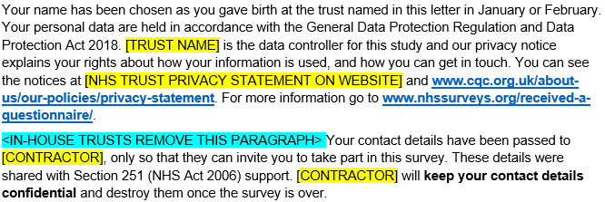
General Data Protection Regulation (GDPR) & National Data Opt-Out Programme
National Data Opt-Out Programme
General data protection regulation (GDPR)
NPSP has received exemption from the National Data Opt-out Programme.
How service users’ personal data is being protected under the GDPR is stated on the reverse side of the covering letter for mailings 1-4:
We will continue to have separate opt-out mechanisms via the dissent posters that need to be displayed across all trusts.
Please note that service users do not have to actively consent to the sharing of their data, for the 2026 Maternity Survey.
Notes:
The sentence ‘These details were shared with Section 251 (NHS Act 2006) support. ‘ has been added based on a request by CAG to explain that contact details of service users have been shared with contractors with S251 support.

Slide 39
Section 251 requirements
We ask you publicise the survey both internally and externally to ensure service users are aware of the survey and have the opportunity to opt-out should they wish. Example materials are available in the 'Publicising the survey’ document.
You can also use the publicity materials we will provide you with.
Ensure a log of maternity service users who have dissented from taking part in the survey is accurately kept.
Ensure the total number of eligible service users who have dissented from the sharing of their details for any purpose other than their clinical care or who have dissented from taking part in the survey specifically are recorded in your sample declaration form and are excluded from your sample.
Section 251 allows service user data to be shared outside of NHS trusts without gaining prior and explicit consent from these service users. In order for their contact data to be shared without consent to a third party, you will need to display the dissent poster and provide 16/17-year-old service users with a leaflet.

Slide 40


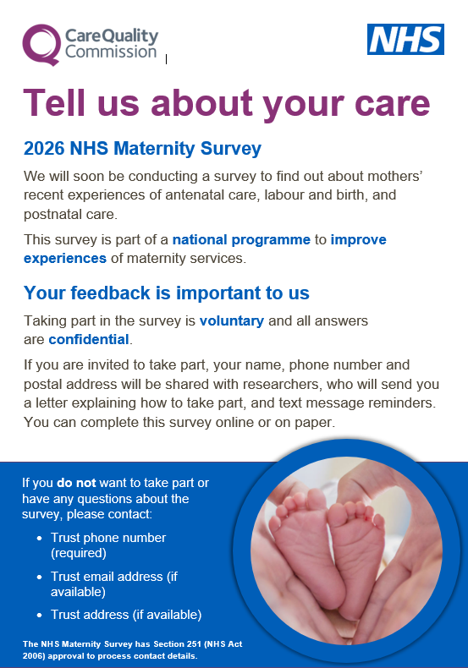
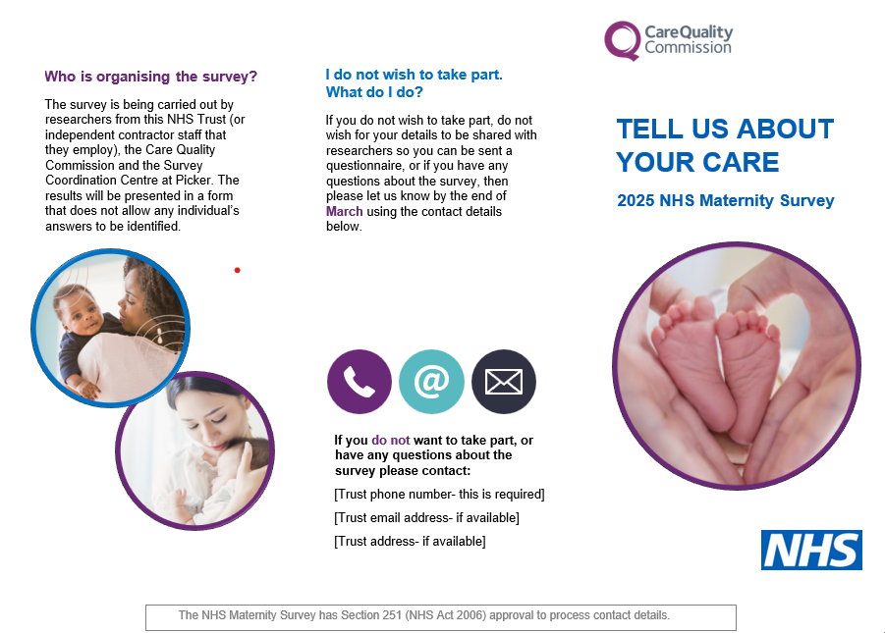
Section 251 requirements: Dissent poster and 16/17-year-olds leaflet
Dissent posters give service users the opportunity to opt out (available on the NHS Surveys website).
Posters MUST be displayed during February (and January for trusts who need to sample back to reach 300 live births) to comply with Section 251 requirements.
Posters are available in English, and have been translated into the most commonly spoken languages in England as well as languages requested by trusts. There are 22 translations available:
Arabic, Bengali, Bulgarian, Chinese Cantonese (Traditional), French, Gujarati, Hindi, Indian Punjabi, Italian, Kurdish Sorani, Lithuanian, Nepali, Polish, Portuguese, Romanian, Russian, Somali, Spanish, Tamil, Tetum, Turkish, Ukrainian and Urdu.
A 16/17-year-olds leaflet should be shared with younger mothers postnatally in hospital or at discharge after birth in February (and January for smaller trusts).

Slide 41
Demographic Batch Service (DBS) Checks

Slide 42
DBS Requirements
Once you draw your sample of eligible service users, this list must be locally checked for deceased service users AND it must be submitted for demographic batch service (DBS) checks:
DBS & local checks requirements
Before mailing 1 | Local checks AND DBS checks at the time of drawing your sample Further deceased checks will be needed if it has been 2 weeks or more since DBS checks prior to sample submission and mailing 1
Before SMS 1 | No checks
Before mailing 2 | Local checks AND DBS checks
Before SMS 2 | No checks
Before mailing 3 | Local checks AND DBS checks
Before SMS 3 | No checks
Before mailing 4 | Local checks AND DBS checks

Slide 43

DBS Requirements
Some contractors have the capability of running DBS checks during fieldwork on the trusts’ behalf.
This removes the requirement for trusts to run DBS checks ahead of mailing two, mailing three and mailing four BUT:
Trusts are still required to run local checks between mailings.
Trusts are still expected to run the initial DBS checks when drawing the initial sample.
NHS Numbers of mother and baby and Full date of birth of mother and baby will be required in the sample sent to your contractor to allow them to conduct DBS checks on your behalf during fieldwork.
Please discuss further with your contractor.

Slide 44
Useful NPSP Instruction Documents
Other instructional documents that are useful for implementing the 2026 Maternity Survey can be found on the NHS Surveys website:
Patient feedback and the NHS Constitution
Setting up a project team
Data protection and confidentiality
Ethical issues, ethical committees and research governance
Collecting data from non-English speaking populations
Publicising the survey
Implementing the survey – practicalities
Submitting samples
Entering and submitting final data
Making sense of the data
Reporting results
Updated trust-level benchmark reports
Universal glossary

Slide 45
Entering fieldwork

Slide 46
Entering fieldwork early / on time
Entering fieldwork on time or earlier will help your trust to maximise responses from minority ethnic groups. You will also likely receive an overall higher response rate, providing your trust with more data.
Ensure you have a survey team in place before you start drawing your sample.
Generate your sample promptly – begin preparing now.
Respond to queries as soon as possible to avoid unnecessary delays.
Ensure there is sufficient resourcing around the time of drawing your sample and answering queries – communicate with your team, handover tasks if people are going to be on leave and let your contractor and the SCC know any updates.
If there are any changes in the survey lead, inform your contractor and the Survey Coordination Centre (SCC).

Slide 47
Key dates

Slide 48
Key dates
More detailed timelines can be found in the Survey Handbook for trusts managing sampling and recruitment in-house and for those using an approved contractor.
Activity | Date
Dissent posters published on website | December 2025
Dissent posters to be displayed | February 2026 and January 2026 for smaller trusts
Section 251 (approval) | February 2026
Publication of sampling materials (follows section 251 approval) | w/c 16th February 2026
Publication of service user - facing materials (follows section 251 approval) | Late February – Early March 2026
Start drawing your sample | 2nd March 2026
Submit sample to contractor | Contractor to confirm
Sample checking (SCC) | 16th March – 13th May 2026
Fieldwork | 20th April –17th July 2026
Trusts receive local results | Autumn 2026
Publication date will be announced here: https://www.cqc.org.uk/publications/surveys/nhs-patient-survey-programme-outline-programme-publication-dates

Slide 49
Questions

Slide 50
Thank you for your time
A copy of the slides will be on the NHS Surveys website
Contact us:
maternity@surveycoordination.com
01865 208127
Project Team (SCC):
Catherine Davidson (Research Associate), Chrysa Lamprinakou (Senior Research Associate), Caroline Killpack (Head of Survey Coordination)

